Slide 1
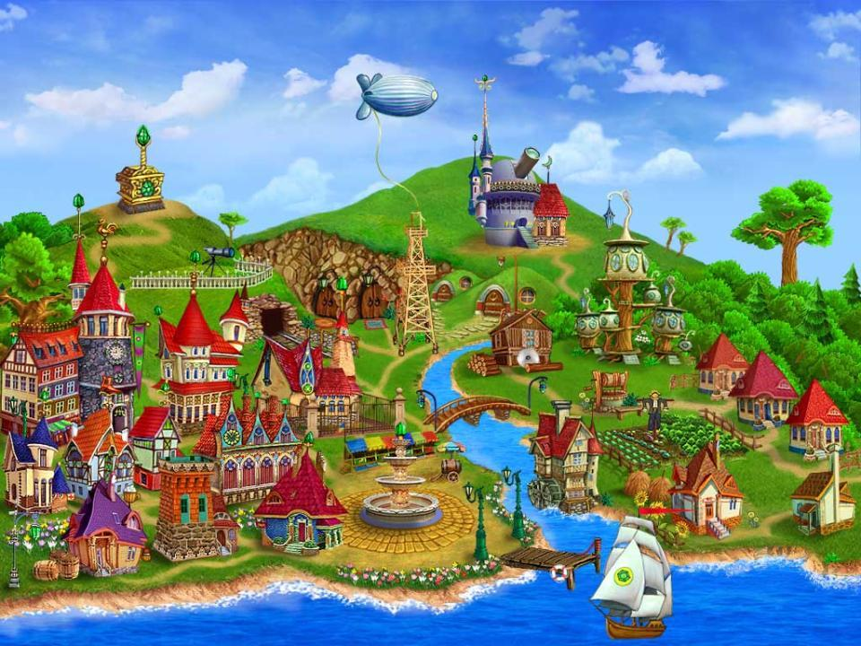
Past Simple

Slide 2


Простое прошедшее время
(Past Simple Tense)
обозначает действия, которые произошли в прошлом

Slide 3

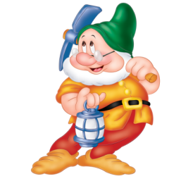
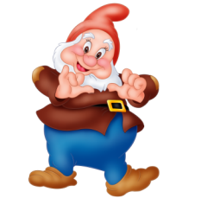
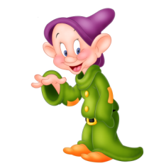
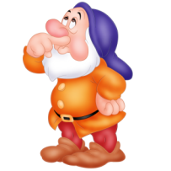
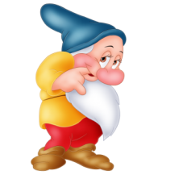

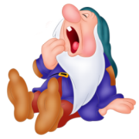
The day before yesterday
Yesterday Last week
…ago
Once Last year Last month

Slide 4


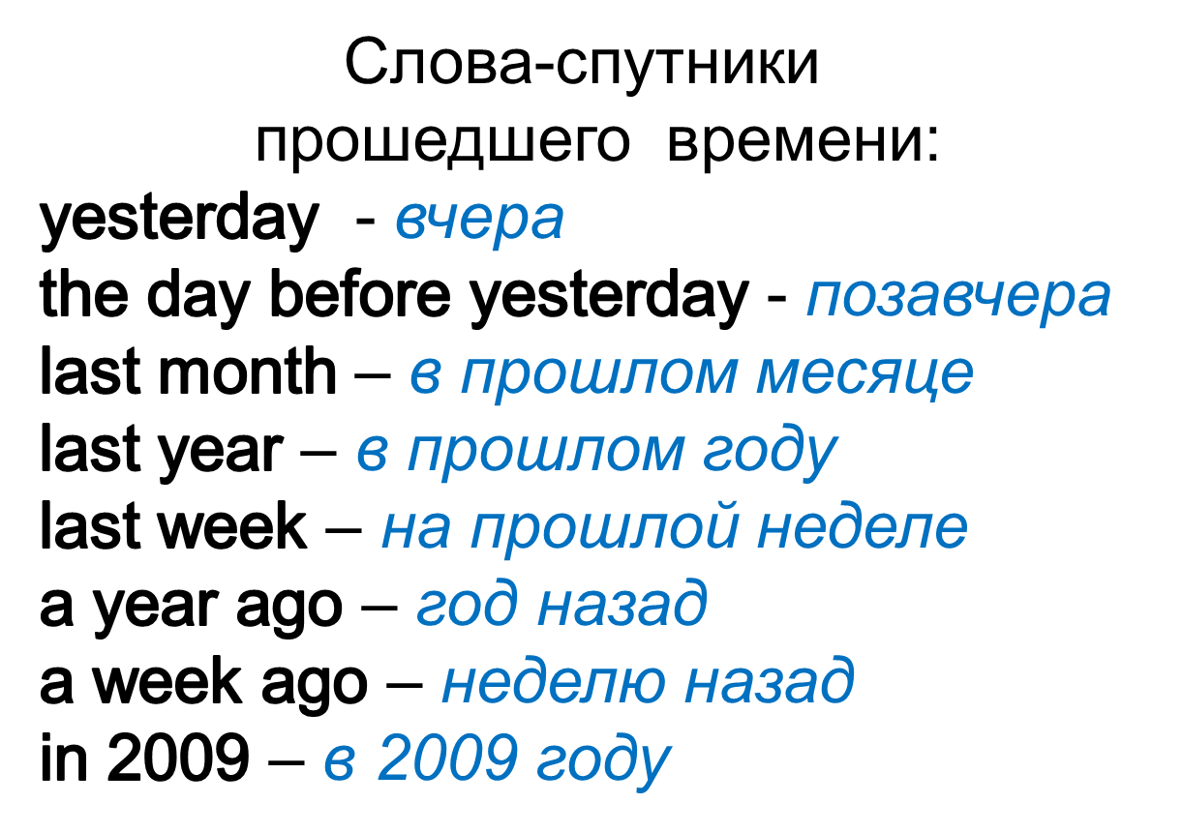

Slide 5

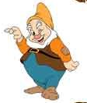
позавчера
в прошлом году
неделю тому назад
10 дней тому назад
прошлым летом
вчера
месяц тому назад
ten days ago
last summer
yesterday
a week ago
the day before yesterday
last year
a month ago

Slide 6

Past Simple Tense
Все глаголы – действия в Past Simple делят на 2 группы
Правильные глаголы Неправильные глаголы
Regular Verbs Irregular verbs

Slide 7

Past Simple Tense
От группы зависит форма глагола в Past Simple
1. Правильные глаголы подчиняются правилу
V + ed
2. Неправильные глаголы правилу не подчиняются, каждый из них изменяется индивидуально, согласно таблице «Неправильных глаголов»

Slide 8
Past Simple Tense
Чтобы поставить глагол в Past Simple Tense следует выполнить следующие действия:
1. Выбрать глагол
2. Определить группу глагола
3. Смотри таблицу «Неправильных глаголов»
Глагол есть в таблице
Глагола нет в таблице
Неправильный Правильный
go - went play – played

Slide 9
Все глаголы делятся на
правильные и неправильные
правильные
like – liked
watch – watched
play – played
count – counted
неправильные
sleep – slept
swim – swam
go – went
have – had

Slide 10


Regular verbs
V → V- ed
[t]
Watched
Walked
Talked
Finished
Looked
[d]
Played
Learned
Tried
Cried
Smiled
studied
[id]
Skated
Wanted
Collected
Painted
needed

Slide 11




watched
learned
cried
collected
played
painted
skated
finished
walked
wanted
looked
talked
tried
smiled
needed
[t]
[d]
[id]

Slide 12



Кенгуренку Кенгуру говорила поутру:
«Надо быстренько вставать, И английский повторять»
To write – wrote – written
To eat – ate –eaten
To speak – spoke – spoken
To break – broke – broken
To come – came – come
To become – became – become
To run – ran – run
To swim – swam – swum
To know – knew – known
To throw – threw – thrown
To blow – blew – blown
To fly – flew – flown
To sing – sang – sung
To ring – rang – rung
To hide – hid – hidden
To bite – bit – bitten
To send- sent – sent
To spend – spent - spent
To sleep – slept - slept
To help – helpt - helpt
To tell – told - told
To sell – sold - sold
To teach – taught - taught
To catch – caught - caught
To fight – fought – fought
To think – thought – thought
To buy – bought – bought
To bring – brought – brought
To cut – cut – cut
To shut – shut – shut
To cost – cost – cost
To lose – lost - lost

Slide 13

They skate in the yard every day.
They skated in the yard yesterday.
The weather is fine today.
The weather was fine yesterday.
We go to the park every day.
We went to the park yesterday.
I see my friend and his mother.
I saw my friend and his mother.
Children have five classes every day.
Children had five classes yesterday.

Slide 14



Образец: I watched TV at night.
You didn’t watch TV at night.
I washed my hands and face ten times.
I played chess with a champion.
I helped my friends to do their homework.
I cleaned my teeth three times.
You didn’t wash your hands and face ten times.
You didn’t play chess with a champion.
You didn’t help your friends to do their homework.
You didn’t clean your teeth three times.

Slide 15




General questions
Did you stay at home?
Did you fly to Rome?
Did your plane arrive at time?
Did you have a good time?
Did you swim in the sea?
Did you watch TV?
Did you spend a lot of money?
Were your journey very funny?
Were you happy?
Were you sad?
Were you angry?
Were you glad?

Slide 16
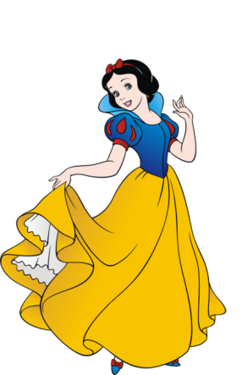


Образец: I watched TV at night.
Did you watch TV at night?
I washed my hands and face ten times.
Did you wash your hands and face ten times?
I played chess with a champion.
Did you play chess with a champion?
I helped my friends to do their homework.
Did you help your friends to do their homework?
I cleaned my teeth three times.
Did you clean your teeth three times?

Slide 17
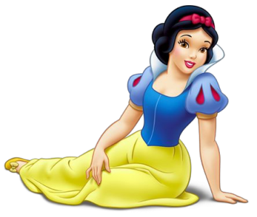


I played football yesterday.
When did you play football?
What did you play yesterday?
Who played football yesterday?
When
Where
Why
Who
How
What

Slide 18

Choose a verb in the correct form
He ____________TV yesterday.
(watch/ watches/ watched)
Tom ___________in the swimming-pool last Sunday.
(swimed / swim/ swam)
My pets ___________ milk two days ago.
(drank/ drinked / drink)
We ___________our room last week.
(clean/ cleaned/ cleaning)
I ____________to the cinema yesterday.
(go/ went/ goes)

